Slide 1




Module 3.3b
How do we train a computer to make decisions?
Living and Working with Artificial Intelligence
Fishy Feature Space Activity#2: Safe vs Poisonous
Developed for the AI4GA (Artificial Intelligence for Georgia) project funded by National Science Foundation awards DRL-2049029 and DRL-2048502.
This work is licensed under the Creative Commons. Attribution-NonComercial-ShareAlike 4.0 International License. https://creativecommons.org/licenses/by-nc-sa/4.0/

Slide 2
Learning Objectives
Students should be able to:
Explain how decision tree classifiers work. (They should have gotten this from Pasta Land but it’s reinforced here.)
Show how training examples can be encoded as feature vectors.
Use MachineLearningForKids to set up and solve a machine learning problem.

Slide 3

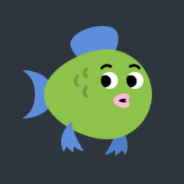








When we worked with your reef/non reef example, only one feature was needed. What if we give a more advanced problem where multiple features determine the differences?
Which fish are poisonous?
Safe:
Poisonous:
We could solve this, but it would take a really long time!

Slide 4
This is where Machine Learning and decision trees come in!
Go to the website: https://machinelearningforkids.co.uk/
In the top center of the screen, click Log in, and then select already registered
Use the username and password that your teacher gave to you to log in
Click on “Go to your projects”
Click on fish classifier, then select “Learn and Test”
Scroll down to the bottom of the page and click “Describe your model”
Go to the next slide for what to do next

Slide 5
Task: Enter 4 new fish into the machine learning program. As you build your fish in Machine Learning for Kids, write down what you select in this table and record if the fish is poisonous.
Fish 1
Body Type
Tail Fin
Dorsal Fin
Pectoral Fin
Body Color
Fin Color
Poisonous?
Fish 2
Body Type
Tail Fin
Dorsal Fin
Pectoral Fin
Body Color
Fin Color
Poisonous?
Fish 3
Body Type
Tail Fin
Dorsal Fin
Pectoral Fin
Body Color
Fin Color
Poisonous?
Fish 4
Body Type
Tail Fin
Dorsal Fin
Pectoral Fin
Body Color
Fin Color
Poisonous?
1=Red
2=Pink
3=Yellow
4=Orange
5=Lime
6=Forest
7=Blue
8=Purple

Slide 6
Decision tree in our notation
Pectoral fins smooth?
no
yes
Body type triangle?
safe
no
yes
safe
poisonous
Notes:
Teacher note: this is a redrawn tree in our tree notation.

Slide 7
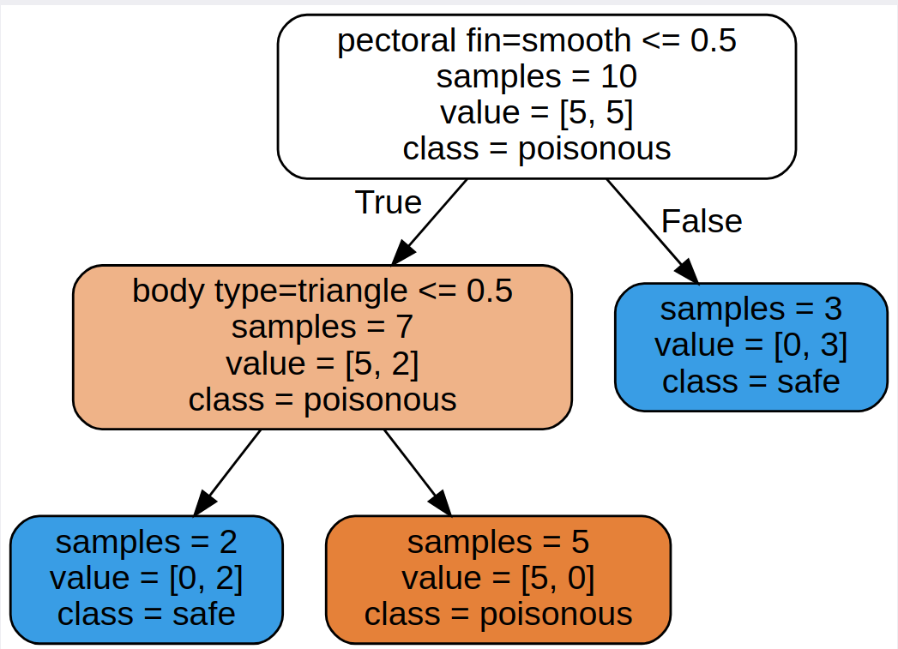
Let’s take a look at how the computer views this decision tree!
1
2
3
4
5
What is being asked in box number 1? A number that is 1 is true, 0 is false.
Answer:
Notes:
After we train the model, we will get a decision tree
This is running using the splitting process
Value = [5,5] => 5 fish in the poisonous and 5 in the safe class
Every node needs to pick a class. Even if it is a terrible assignment.
The deep blue node labeled safe because all the samples are in the safe class.
Notice that only 5 of the 6 samples are poisonous.
Why is the root node white? It is getting have of the samples wrong. It is white because it is halfway between blue and orange.

Slide 8
Let’s take a look at how the computer views this decision tree!
1
2
3
4
5
What is being asked in box number 2? A number that is 1 is true, 0 is false.
Answer:
Notes:
After we train the model, we will get a decision tree
This is running using the splitting process
Value = [5,5] => 5 fish in the poisonous and 5 in the safe class
Every node needs to pick a class. Even if it is a terrible assignment.
The deep blue node labeled safe because all the samples are in the safe class.
Notice that only 5 of the 6 samples are poisonous.
Why is the root node white? It is getting have of the samples wrong. It is white because it is halfway between blue and orange.

Slide 9
Let’s take a look at how the computer views this decision tree!
1
2
3
4
5
What does box number 3 tell us?
Answer:
Notes:
After we train the model, we will get a decision tree
This is running using the splitting process
Value = [5,5] => 5 fish in the poisonous and 5 in the safe class
Every node needs to pick a class. Even if it is a terrible assignment.
The deep blue node labeled safe because all the samples are in the safe class.
Notice that only 5 of the 6 samples are poisonous.
Why is the root node white? It is getting have of the samples wrong. It is white because it is halfway between blue and orange.

Slide 10
Let’s take a look at how the computer views this decision tree!
1
2
3
4
5
What does box number 4 tell us?
Answer:
Notes:
After we train the model, we will get a decision tree
This is running using the splitting process
Value = [5,5] => 5 fish in the poisonous and 5 in the safe class
Every node needs to pick a class. Even if it is a terrible assignment.
The deep blue node labeled safe because all the samples are in the safe class.
Notice that only 5 of the 6 samples are poisonous.
Why is the root node white? It is getting have of the samples wrong. It is white because it is halfway between blue and orange.

Slide 11
Let’s take a look at how the computer views this decision tree!
1
2
3
4
5
What does box number 5 tell us?
Answer:
Notes:
After we train the model, we will get a decision tree
This is running using the splitting process
Value = [5,5] => 5 fish in the poisonous and 5 in the safe class
Every node needs to pick a class. Even if it is a terrible assignment.
The deep blue node labeled safe because all the samples are in the safe class.
Notice that only 5 of the 6 samples are poisonous.
Why is the root node white? It is getting have of the samples wrong. It is white because it is halfway between blue and orange.

Slide 12
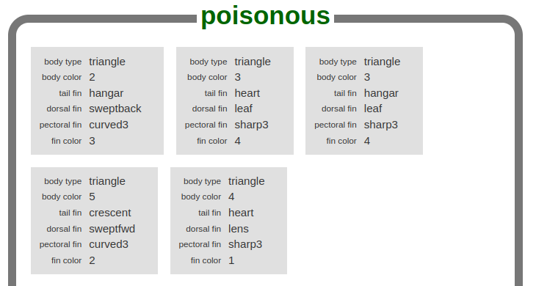
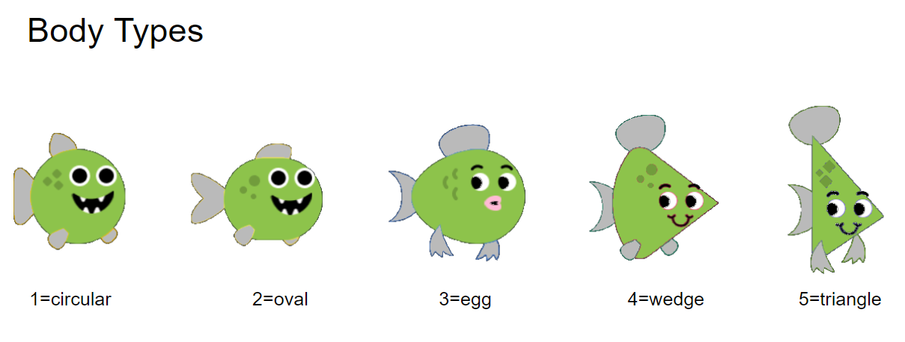
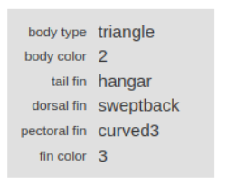
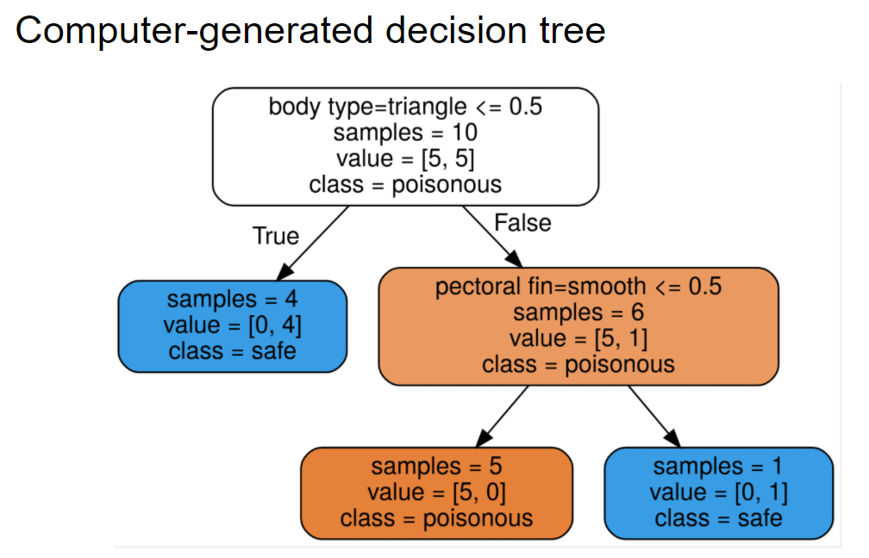
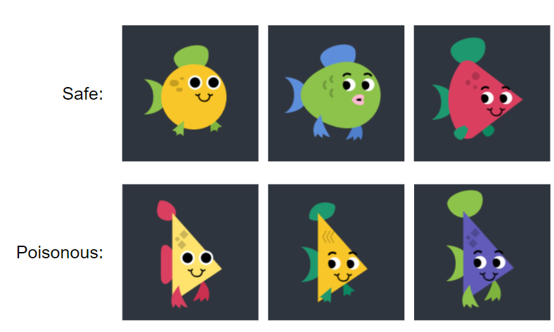

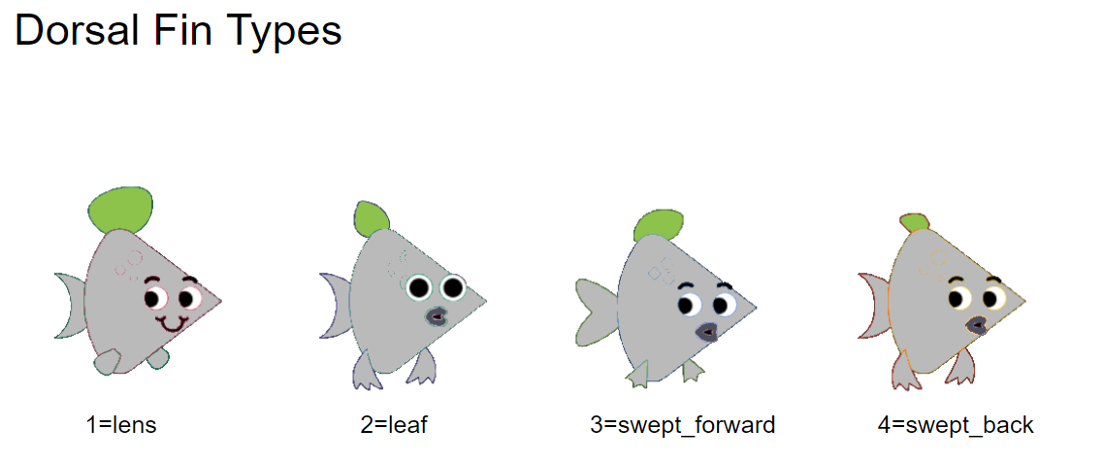
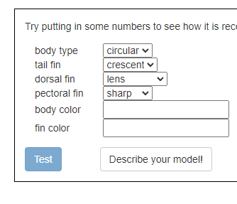
The Machine Learning Pipeline
Collect your data
Design a feature set
Code your data using the feature set
Label your data
(Assign each item to a class)
Train a classifier
Test the model

Slide 13
Task: Using Machine Learning for Kids and what you just learned, create two more poisonous fish and two more non-poisonous fish. Record the fish below.
Fish 1
Body Type
Tail Fin
Dorsal Fin
Pectoral Fin
Body Color
Fin Color
Poisonous?
Fish 2
Body Type
Tail Fin
Dorsal Fin
Pectoral Fin
Body Color
Fin Color
Poisonous?
Fish 3
Body Type
Tail Fin
Dorsal Fin
Pectoral Fin
Body Color
Fin Color
Poisonous?
Fish 4
Body Type
Tail Fin
Dorsal Fin
Pectoral Fin
Body Color
Fin Color
Poisonous?
1=Red
2=Pink
3=Yellow
4=Orange
5=Lime
6=Forest
7=Blue
8=Purple

